Slide 1
Cushion Catapult
16
Daniel peter Culliver
FOR TEAM GCHD

Slide 2
Table of Contents
Introduction
Task Definition
Our Progression
Initial Assumptions
Measurements
Initial Model
Second Model
Final Model

Slide 3
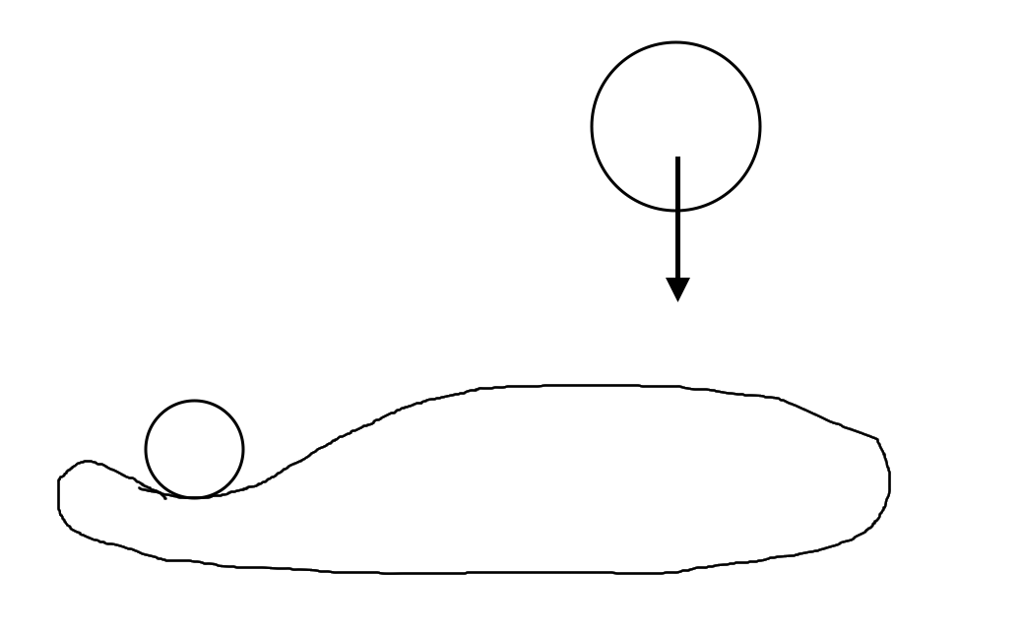
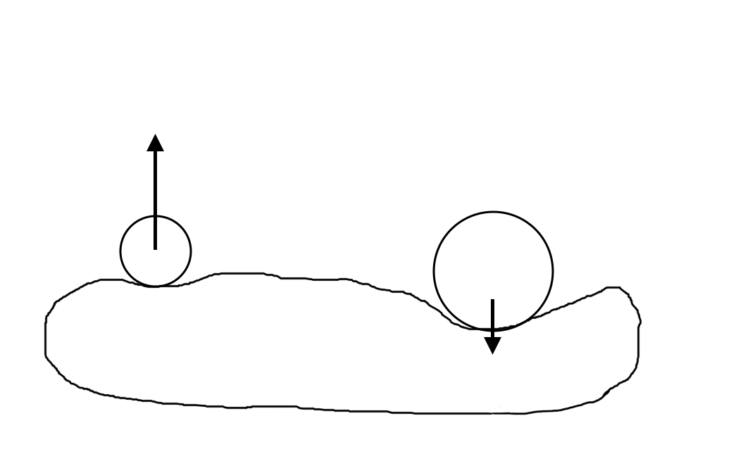
Task Definition
Introduction
Place an object on a large air cushion and drop several other objects in such a way that the first object is catapulted away. Investigate how the exit velocity depends on relevant parameters.
Notes:
Rychlost v okamžiku opuštění

Slide 4
Our Progression
Introduction
1) Conservation of energy
2) An elastic collision
3) A search for something better
Notes:
Myšlenkový pochod – Dochází k

Slide 5
Physical Assumptions
Introduction
Ideally, the air cushion should not cause any loss of energy
Such an air cushion would be:
Inelastic
Massless (or at least of negligible mass, compared to the objects)
Additionally, object 1 and object 2 should only interact with each other through the air in the air cushion
Meaning that the depressions from object 1 and object 2 do not affect each other
Notes:
- Nepružný
- Nehmotný (vůči objektům)
- Pohyb objektu 1 a objektu 2 jsou nezávislé na sobě
- Závislost jen přes tlak, nepůsobí na sebe přes prohnutí vaku
- Vak mnohem delší v jednom směru, než ve druhém

Slide 6
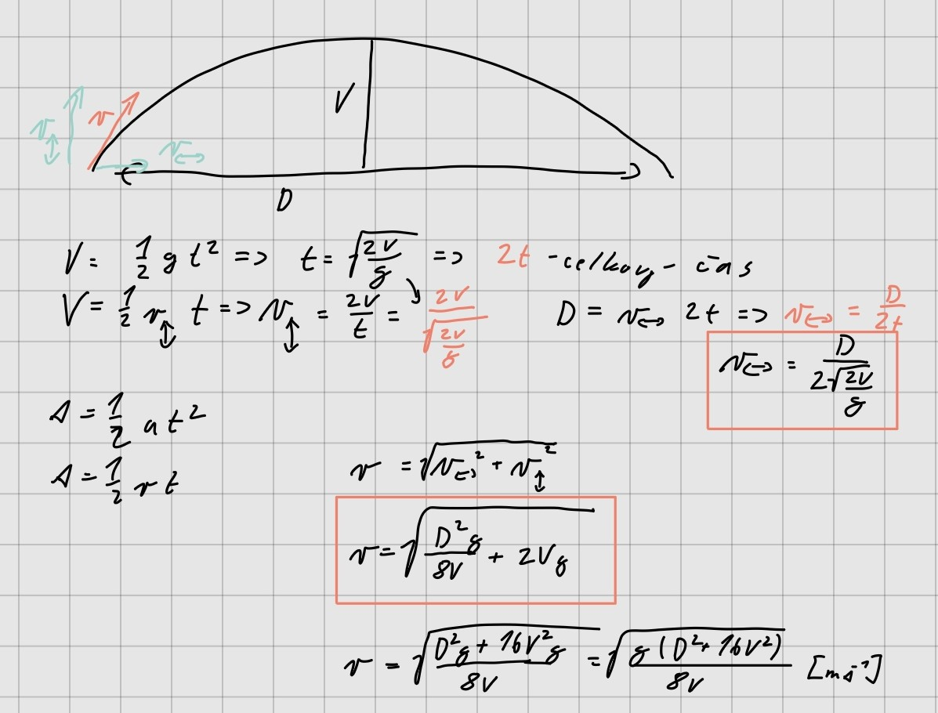
Base Measurements
Measurements
Projectile motion
Data captured by video recording
Notes:
Let katapultovaného objektu připomíná šikmý vrh (neletí to přímo nahoru)

Slide 7
Measurements

Slide 8
Measurements

Slide 9
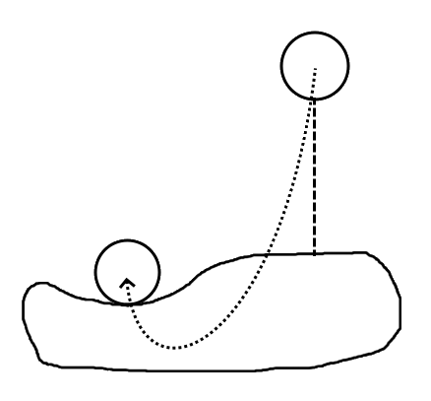
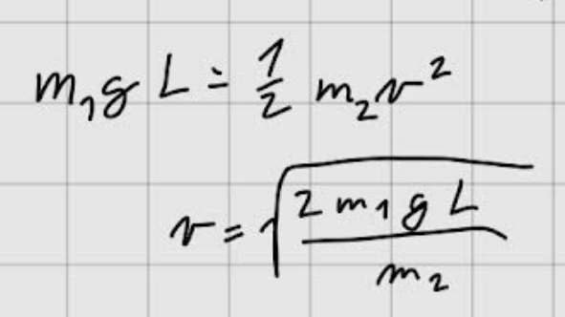
Conservation of Energy
Initial Model
A model of the system, where potential energy is perfectly converted to kinetic
Notes:
První model - triviální úvaha
měření kamerou - počítali jsme teoretickou rychlost objektu a porovnali jsme se změřenou

Slide 10
Conservation of Energy
Initial Model

Slide 11
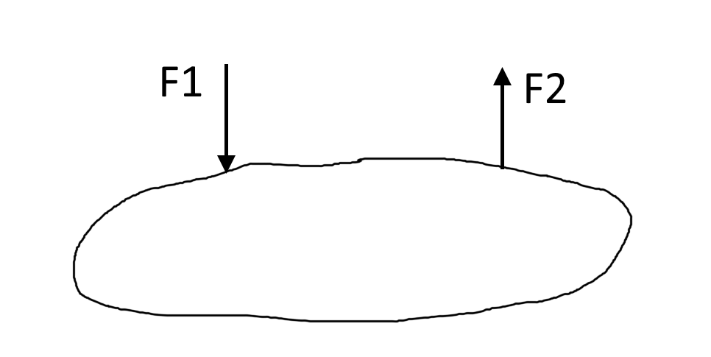

Elastic Collision
Second Model
An elastic collision occurs when $F_{1} = F_{2}$
Different weight ratios conserve different fractions of energy
For example for $\frac{m_{2}}{m_{1}}=\frac{2}{1}$ the ratio of energies $\frac{E_{2}}{E_{1}}=\frac{16}{18}$

Slide 12

A Comparison of Models
Second Model
For a mass ratio of $\frac{m_{2}}{m_{1}}=\frac{1}{2}$, where $m_{2}$ is the catapulted object and $m_{1}$ is the falling object
Conversion of energy:
$\frac{E2}{E1}=1$ => $\frac{v_{2}}{v_{1}}= \sqrt{2}$
Elastic collision:
$\frac{E_{2}}{E_{1}}=\frac{16}{18}= \frac{8}{9}$ => $\frac{v_{2}}{v_{1}}= \frac{4}{3}$

Slide 13

Is an Elastic Collision the Limit?
Third Model
We cannot reach better results than a perfect conversion of energy, but can we reach better results than an elastic collision?
Such a system would require $F_{1}≠F_{2}$

Slide 14
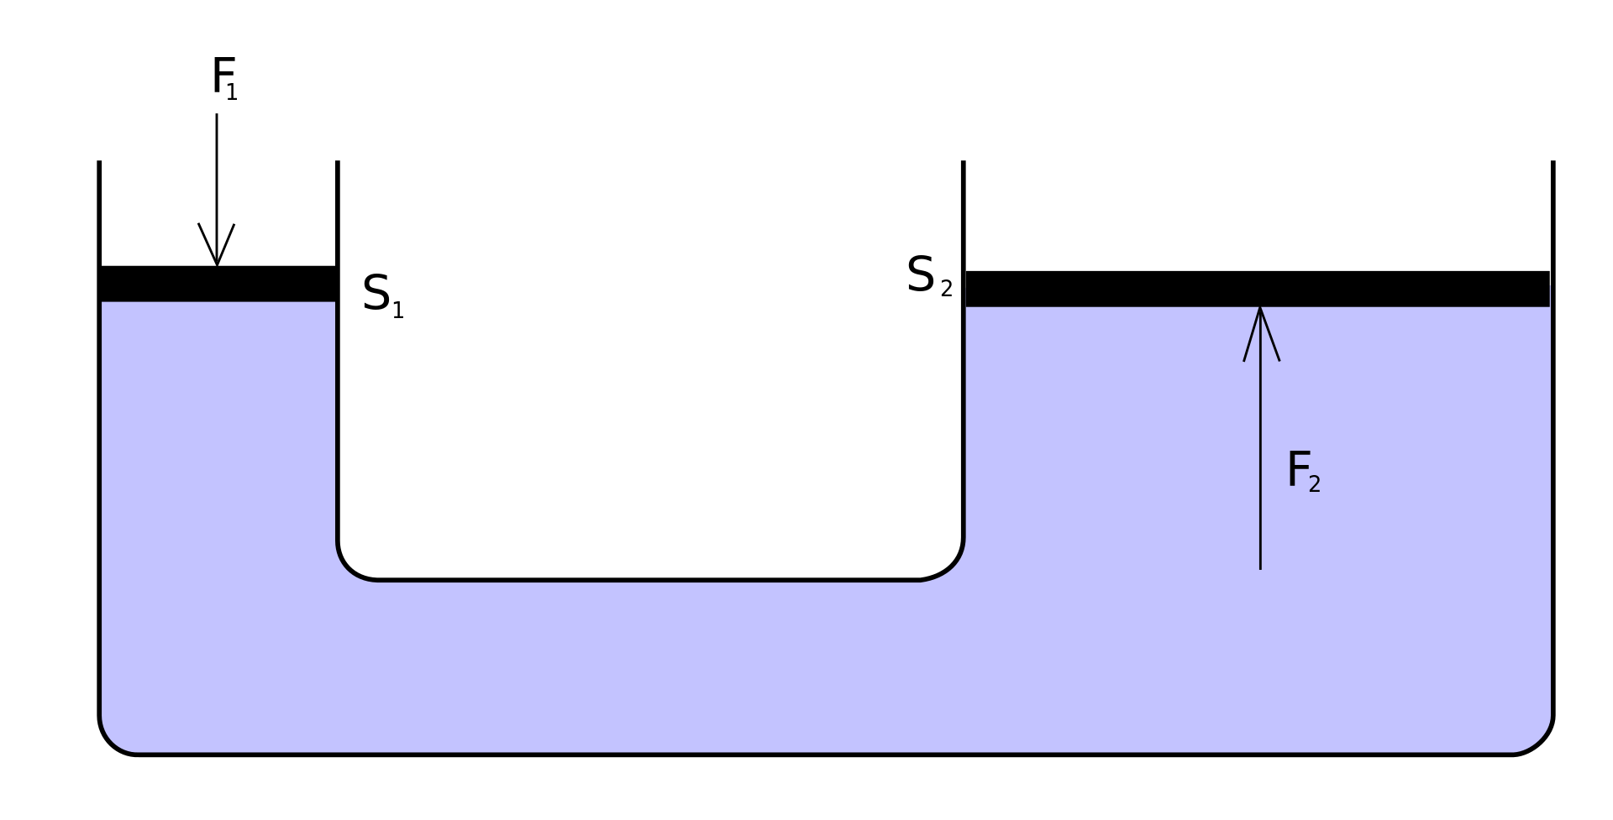

Hydraulic Press
Third Model
The interaction between object 1 and object 2, with the air cushion as a medium, could behave similarly to a hydraulic press
$$F_{2}=F_{1}∙\frac{S_{2}}{S_{1}}$$

Slide 15
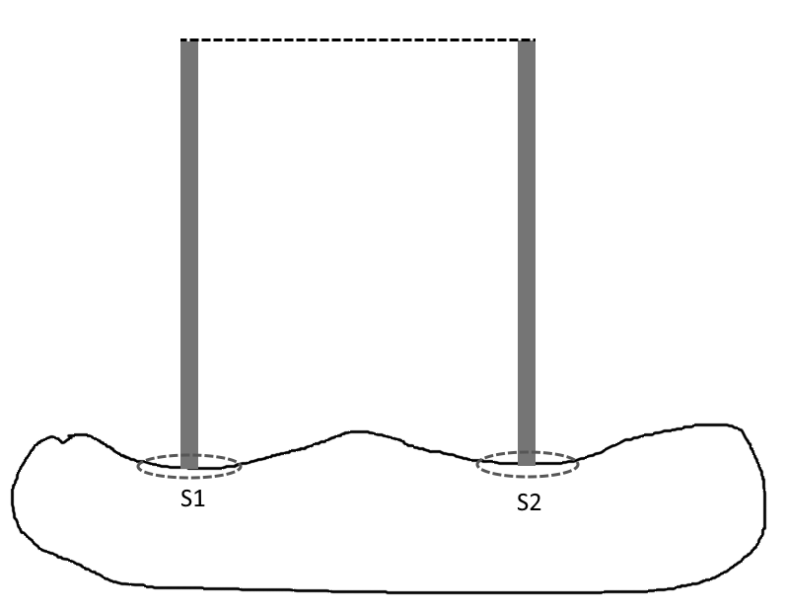
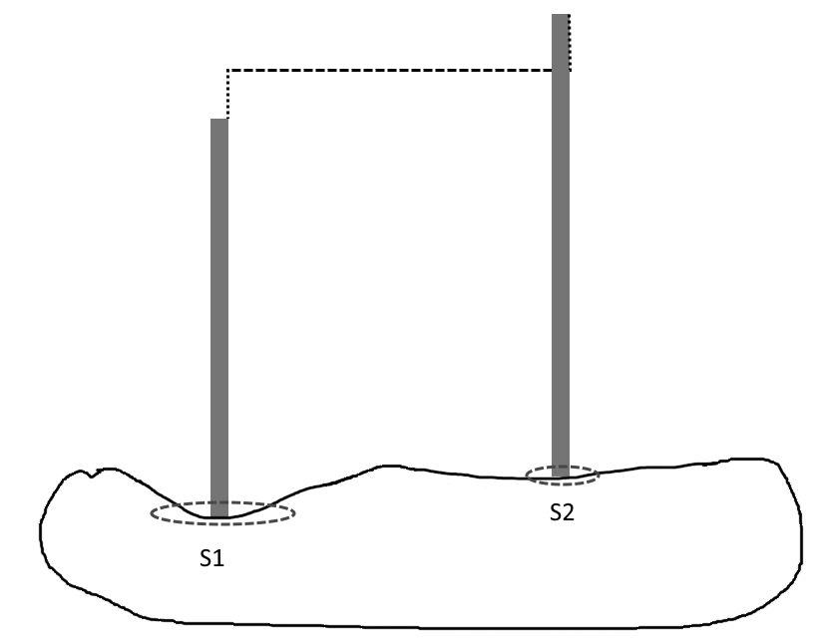
Hydraulic Press
Third Model
The effective area of object 1 and object 2 as pistons is variable
The area increases the deeper the object is in the air cushion

Slide 16
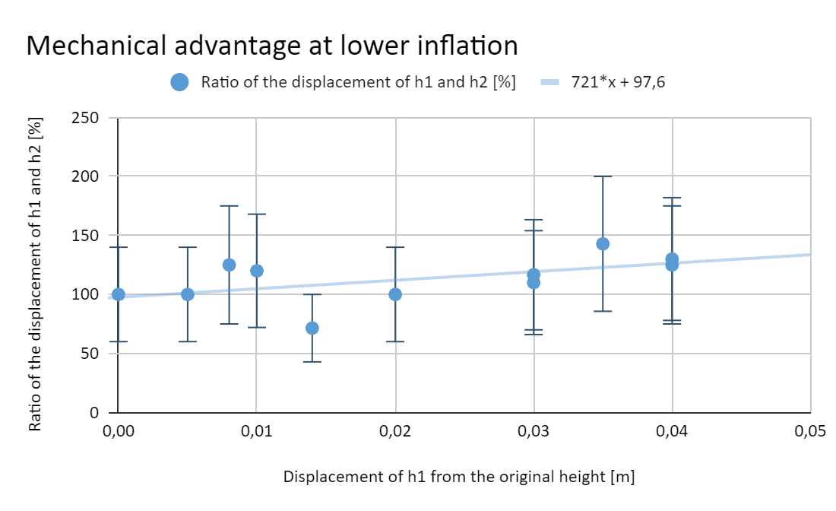
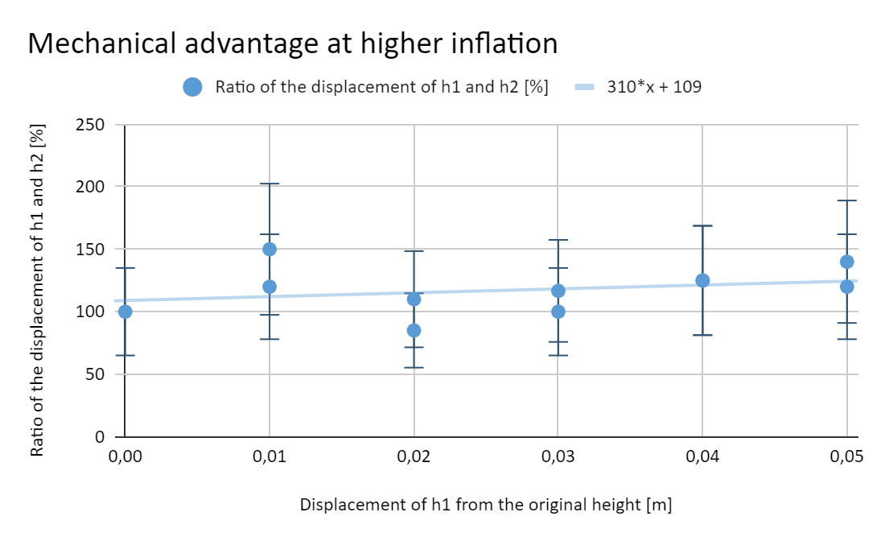
Validating the Model
Third Model
We performed a rough measurement, which confirmed the model of a hydraulic press
Further, more thorough, validation is in process

Slide 17
Summary
Summary
We set conversion of energy as the upper limit of the system
We recognised the possibility of an elastic collision
We believe the model of a hydraulic press is a more effective model than an elastic collision
In the model of a hydraulic press, the effective area of the objects plays an important role
The effective area increases with depth
The effective area most likely decreases with inflation of the air cushion

